Slide 1
Linux setup & Performance Tuning
Shobnom Mushtary
Lecturer, CSE
Dhaka International University (DIU)

Slide 2
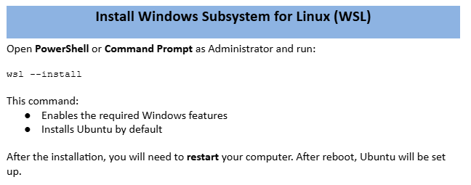

Slide 3
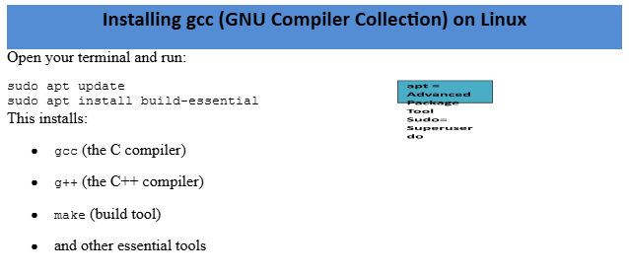


Slide 4
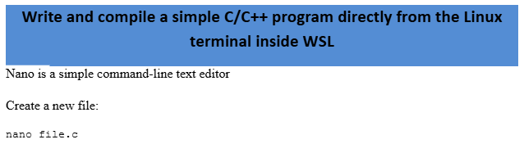

Slide 5
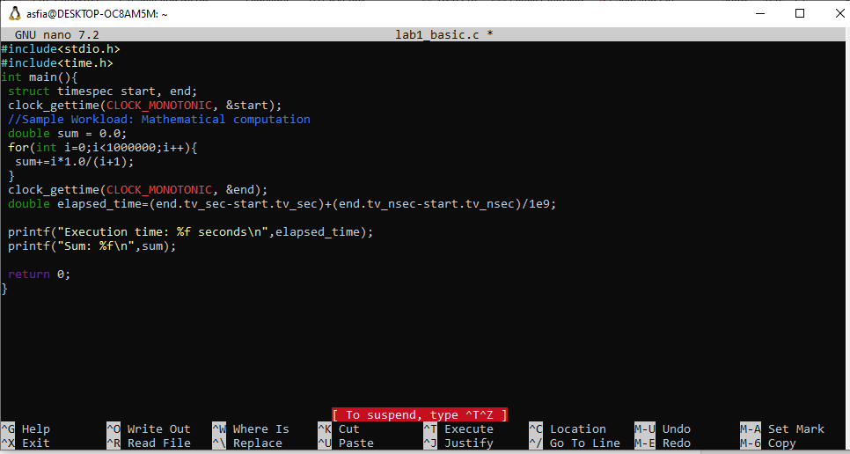
Lab Exercise 1: Basic Timing with clock_gettime()

Slide 6
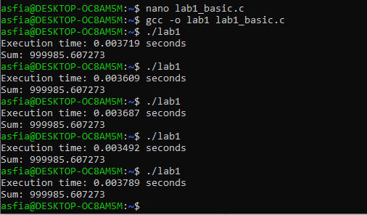
To Save the file and Exit:
Ctrl + O → Enter
Ctrl + X
Questions to Answer
1. What time did you get?
2. Run the program 5 times. Do you get consistent results?
Compile and Run

Slide 7
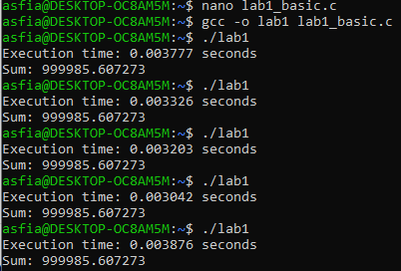
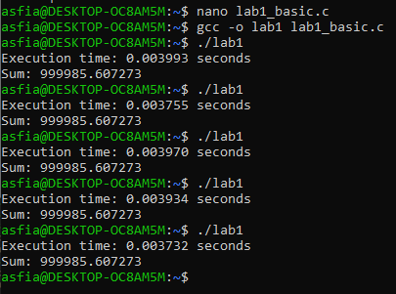
Modify your code to test different clock types:
// Try these different clocks:
  clock_gettime(CLOCK_MONOTONIC, &start); // Standard choice
  clock_gettime(CLOCK_MONOTONIC_RAW, &start); // No NTP adjustments
  clock_gettime(CLOCK_PROCESS_CPUTIME_ID, &start); // CPU time only

Slide 8
  clock_gettime(CLOCK_MONOTONIC_RAW, &start); // No NTP adjustments

Slide 9
  clock_gettime(CLOCK_PROCESS_CPUTIME_ID, &start); // CPU time only
Question: Which clock type gives you the most consistent results for performance measurement?

Slide 10
THANK YOU

